Slide 1
Data Distribution-Based Change Detection
Methods in SWaT
Team Hybrid Minds
Máté Hekfusz, Vrushali Mahajan, Nada Saleh Awadh Al-Amodi, Fatima Assendal

Slide 2
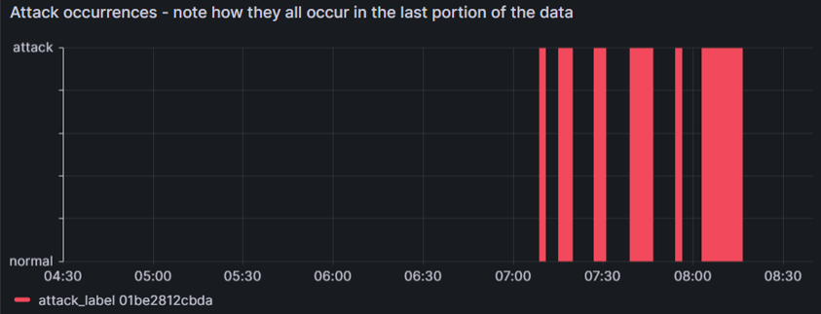
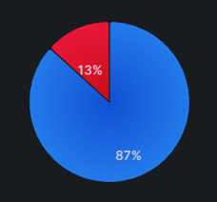
Dataset
Secure Water Treatment (SWaT) – A4 & A5
Data from one run of a water treatment plant testbed on 20 July 2019
4-hour runtime, sensor data recorded every second, 15996 records total
Normal operation for ~3 hours, then 6 attacks on various parts of the system in the last hour

Slide 3
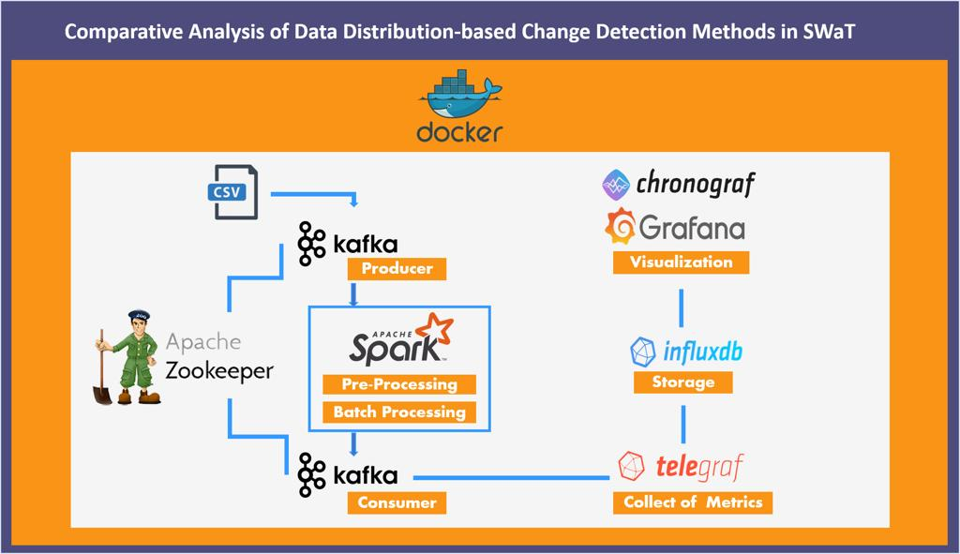
Pipeline

Slide 4
Pipeline – 1. Data ingestion and preprocessing
Set up the Kafka cluster manager CMAK to monitor data flow
Load dataset from sheet and ingest the relevant columns into Kafka, turning it into a data stream
  The key for each record is its timestamp
Receive the data in Spark Streaming and preprocess it before feeding it back into Kafka in a different topic
  Format cleanup, aggregate statistics, attack labelling, etc

Slide 5
Pipeline – 2. Change detection
Implement data distribution-based streaming change detection algorithms
Consume the preprocessed data from Kafka and run each algorithm
  Six algorithms available: kdq-tree, PCA-CD, 1-class-SVM, CUSUM, Kolmogorov–Smirnov test, and Cramér–von Mises test
Record detection results: true and false detections, detection delay
Graph them!

Slide 6
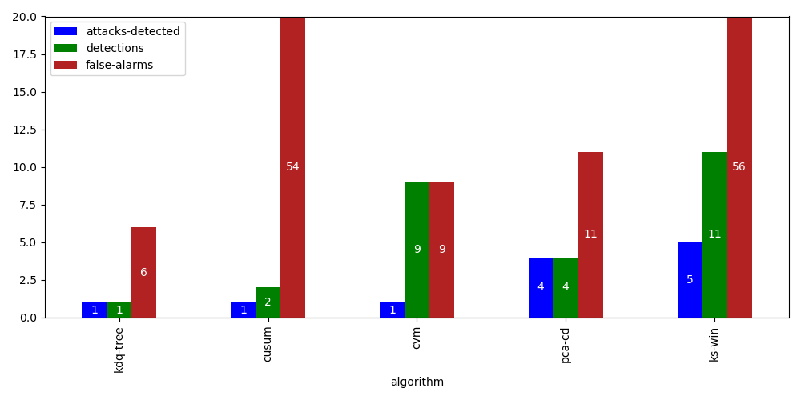
Pipeline – 2. Change detection

Slide 7
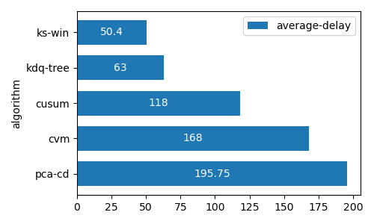
Pipeline – 2. Change detection
Note: 1-class-SVM is excluded from the graphs as it had very poor performance and would’ve skewed the graphs.

Slide 8
Pipeline – 3. Data storage and batch training
Set up Telegraf to capture preprocessed Kafka records and send them to InfluxDB
  Telegraf is configured such that the timestamp of each record is set to its timestamp in the original dataset (that lovely July day in 2019)
Query the data from InfluxDB and train a Decision Tree model on it
  Setup: Train model on the first three hours of normal data plus the first three attacks, test on the rest
  Results: ~71% accuracy, not great, not terrible (better than RF and SVM)

Slide 9
Pipeline – 4. Visualization
Hook up Grafana to InfluxDB to complete the TIG stack
  A bit more complicated than it sounds, with tokens and auth requirements
Connect Chronograf for an additional visualization option
Write queries in Flux or InfluxQL and create magical dashboards!

Slide 10
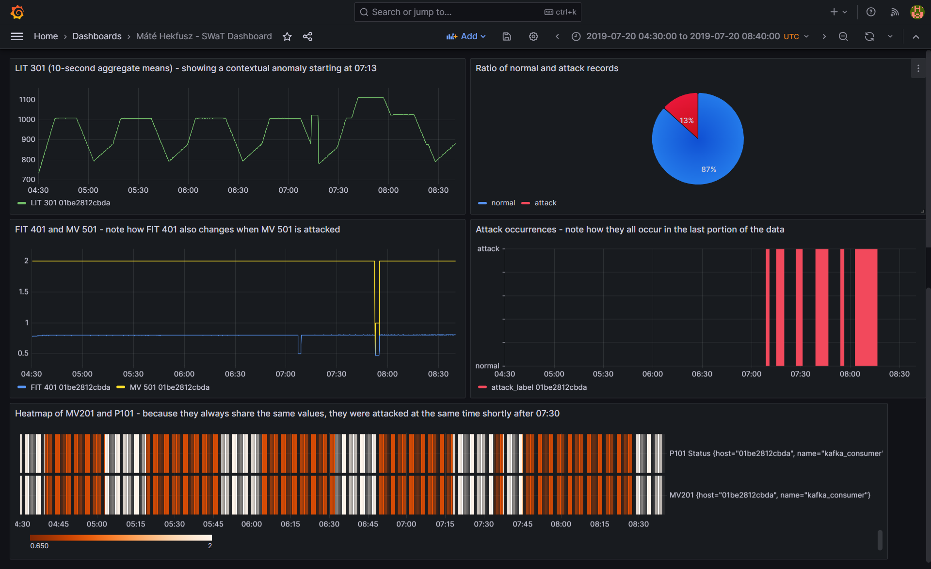

Slide 11
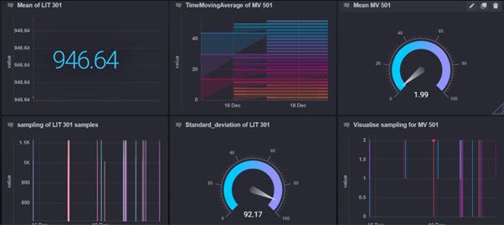

Slide 12
Contributions
Máté: docker-compose file, Kafka data ingestion as stream, Kafka and Spark connection, Spark data transformation, TIG stack setup and configuration, change detection algorithms (kdq-tree, PCA-CD, KS-WIN, 1-class-SVM), batch training, detection results tracking and graphing, Grafana dashboard, readme instructions, report, presentation
Vrushali: Kafka and Spark connection, Spark sliding window aggregation, change detection algorithms (CUSUM, CvM, KDE), batch training, Chronograf setup and configuration, Chronograf dashboard, InfluxDB visualizations, report, presentation
Nada: dataset procurement, data exploration, attack labelling, report
Fatima: report

Slide 13
Thank you for your attention!
Our project is available with detailed instructions for running the entire pipeline in our Github repo.

